Slide 1
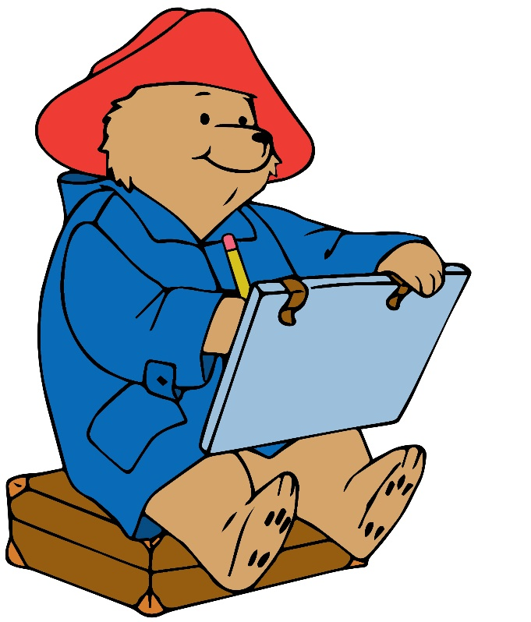
Afonso
Arman
Liam
Victor
Jasmin
Nova

Slide 2
Amanda
David
Gro
Enes
Stella
Matheo

Slide 3
Thea
Leon
Noah
Martine
Emilia
Sindre

