Slide 1

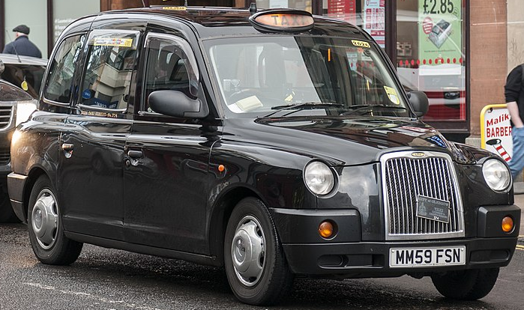

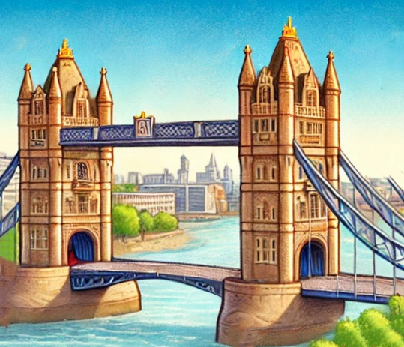

a red bus
a black cab
a nice letter
an old bridge
a red post box

Slide 2


Sett strek fra bilde til riktig ord
a black cab
a red bus
a red post box
an old bridge
a letter

Slide 3
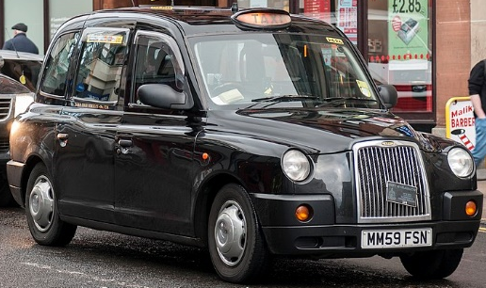


Skriv ordene på engelsk

Slide 4

Write the word 5 times
bus_________________________
_____________________________
_____________________________
_____________________________
____________________________
____________________________
______________________________
_____________________________
_____________________________
_____________________________

Slide 5
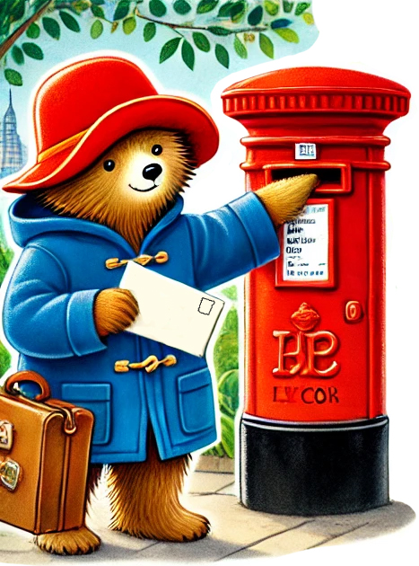
Skriv inn ordene som mangler
Paddington sees a ______post box.
He sends a ______ postcard to Aunt Lucy.
Paddington takes a red ______ to see the city.
He walks over an ________ bridge.
Paddington takes a ______ cab home.

Slide 6

Skriv inn hva dette heter på engelsk
black cab – oldbridge - red bus- Paddington

